Slide 1
A Comparison of Frameworks for Ethics in Statistical Practice
Jeri Mulrow | Vice President & Director
Statistics & Data Science | Westat
0

Slide 2
Acknowledgements
  Follows on to two prior presentations at JSM and CSP on ethical frameworks for statistical practice.
  Built on work by Rochelle E. Tractenberg in 2020, “Concordance of professional ethical practice standards for the domain of data science: A white paper. Published in the Open Archive of the Social Sciences (SocArXiv), DOI 10.31235/osf.io/p7rj2.

Slide 3
Overview of frameworks
Comparison of frameworks
Role of organizations

Slide 4
Ethical Framework
American Statistical Association (ASA) – Ethical Guidelines for Statistical Practice 2022
  Statistical practitioner includes all who engage in statistical practice, regardless of job title, profession, level or field of degree.
  Guidelines are intended for individuals but principles are relevant to organizations that engage in statistical practice.
  “Society benefits from informed judgments supported by ethical statistical practice.”
  Outlines eight (8) areas of responsibility for individuals plus an appendix outline responsibilities of organizations.

Slide 5
Ethical Framework
2. International Statistical Institute (ISI) – Declaration on Professional Ethics 2010, reaffirmed 2017
  The definition of statistician goes well beyond those with formal degrees in the field to include a wide array of creators and users of statistical data and tools.
  Seeks to document widely held principles of the statistics profession.
  Recognizes that one principle may impede the operation of another and that statisticians may have to make choices between principles.
  Outlines three (3) shared professional values and 12 ethical principles.

Slide 6
Ethical Framework
3. Royal Statistical Society (RSS) – Code of Conduct 2014
  Code is intended to define the actions and behaviors expected of RSS Statistical Fellows.
  RSS is a professional society. Through its members, it has an obligation to provide the best possible statistical service and advice. Fellows are expected to maintain the highest standards.
  Professional membership of the Society is an assurance of ability and integrity.
  13 Rules of Professional Conduct plus dispensary procedures.

Slide 7
Ethical Framework
4. Institute of Electrical and Electronics Engineers (IEEE) – Code of Ethics 2010
  “We, the members of IEEE, in recognition of the importance of our technologies in affecting the quality of life throughout the world, and in accepting a personal obligation to our profession, its members, and the communities we serve, do hereby commit ourselves to the highest ethical and professional conduct…”
  10 rules of conduct.
  IEEE Ethics – 2023 conference held May 18-20, 2023 at Purdue University.

Slide 8
Ethical Framework
5. Federal Data Strategy – Data Ethics Framework 2021
  “Decisions made with data touch every aspect of American life….The Federal Government plays a critical role in setting the examples of ethical oversight by making responsible data decisions and supporting proven values that promote the public good…The ethical use of data is both an individual and organizational responsibility.”
  Applies to all data types and data users who work in the Federal Government or as agents of the government (researchers, contractors, etc.).
  7 data ethics tenets that include guidance for both federal leaders and data users plus references to additional resources.

Slide 9
Ethical Framework
6. Artificial Intelligence Ethics Framework for the Intelligence Community 2020
  Intended to guide personnel on whether and how to procure, design, build, use, protect, consume and manage AI and other advanced analytics.
  Intended to provide a reasoned approach to judgement to Artificial Intelligence.
  6 principles plus 10 areas of specific consideration when embarking on AI projects.

Slide 10
Ethical Framework
7. Association for Computing Machinery (ACM) – Code of Ethics and Professional Conduct 2018
  “Computing professionals’ actions change the world. To act responsibly, they should reflect upon the wider impacts of their work, consistently supporting the public good. The ACM Code…expresses the conscience of the profession.”
  Intended to guide anyone who uses computing technology (practioners, instructors, students, influencers, etc.) and to serve as a basis for ethical decision-making.
  7 general ethical principles, 9 professional responsibilities, 7 professional leadership principles, and compliance with the Code.

Slide 11
Overview of frameworks
Comparison of frameworks
Role of organizations

Slide 12
Concordance (Alignment ) in Ethical Frameworks
High degree of concordance on many basic tenets/principles
  Individual practioners
    Professionalism
      Integrity, accountability, competency, continual upgrading of skills & knowledge
      Recognition of authorship & IP
      Disclosure of conflicts of interest
      Avoidance of harassment & discrimination in work
      Work for the “greater good” & advance public knowledge
    Transparency of work
      Document & communicate methods, share data to extent possible
      Disclose limitations to data & methods
      Provide mechanisms/procedures to correct errors in work
      Advance public knowledge

Slide 13
Concordance (Alignment ) in Ethical Frameworks
High degree of concordance on many basic tenets/principles
  Individual practioners
    Integrity of data & methods
      Understand & communicate limitations of data & methods
      Ensure appropriate uses of data & methods
      Understand & communicate impact of results
      Create processes to reassess and re-validate methods over time
    Respect privacy & confidentiality

Slide 14
Concordance (Alignment ) in Ethical Frameworks
Not as high, but still good, of a degree of concordance
  Individuals
    Promote public good, protect human & animal welfare
    Respect for public, individuals & communities
    Balance competing judgements
    Avoid harm, engage in pro bono activities, foster public awareness
  Role of Leaders
    Advocate for ethical behaviors
      Professionalism, transparency, etc,
      Uphold laws, regulations, statutes
    Promote professionalism
    Promote respect for others
    Uphold ethical standards
    Support transparency

Slide 15
Concordance (Alignment ) in Ethical Frameworks
Lower degree of concordance
  Sanctions for misconduct

Slide 16
Overview of frameworks
Comparison of frameworks
Role of organizations

Slide 17
Concordance (Alignment ) in Ethical Frameworks
Role of organizations (ACM & ASA)
    Expect adherence to ethical standards
    Protect those that adhere
    Use competent personnel
    Promote professional development
    Support transparency & objective statistical practices
    Consider impact on society of methods & results
    Manage resources to maintain ethical standards

Slide 18

Keeping a Culture of Ethics
A culture is not infallible.
Must have vigilance and diligence!
Proactively engage individual practioners, leaders, officials or other decisionmakers
Regularly evaluate and update policies
and practices to maintain a focus on ethics
Actively work to maintain credibility
and reputation
Stay abreast of relevant communities, including professional organizations
and stakeholders

Slide 19
Thank You
Jeri Mulrow | jerimulrow@westat.com
240-429-9181

Slide 20
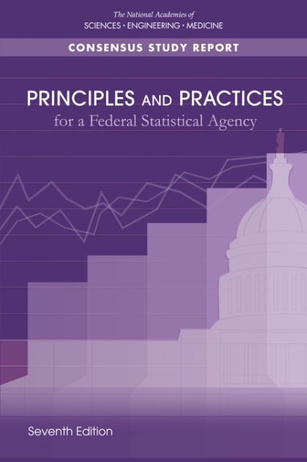

Five Principles & 10 practices for a Federal Statistical Agency
Five principles
Relevance to policy issues and society
Credibility among data users and stakeholders
Trust among the public and data providers
Independence from political and other undue influence
Continual improvement and innovation
4 of 10 practices focused on ethical behaviors
Commitment to quality & professional standards
Respect for data providers & protection of their privacy
Dissemination (wide) of statistical products & information
Openness of sources of data and limitations
7th Edition of Principles and Practices for a Federal Statistical Agency | National Academies

